Slide 1
Introduction to Arduino

Slide 2
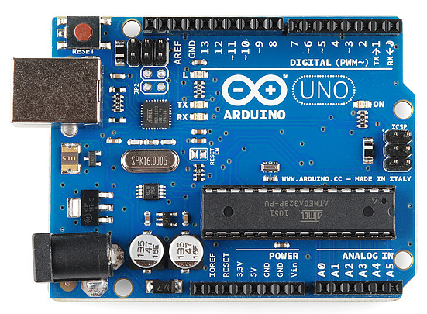
1.1 What is an Arduino?
Arduino is an open-source platform used for building electronics projects.
Arduino consists of both a physical programmable circuit board (often referred to as a microcontroller) and a piece of software, or IDE (Integrated Development Environment) that runs on your computer, used to write and upload computer code to the physical board.

Slide 3
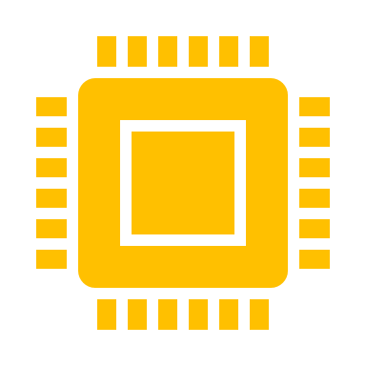
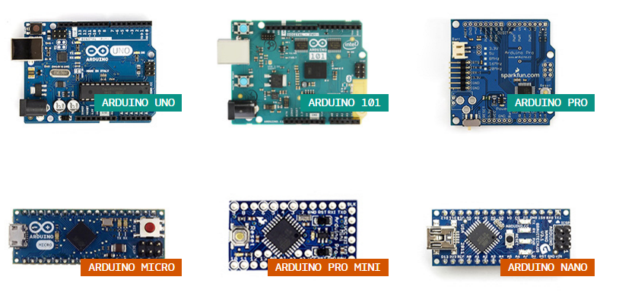
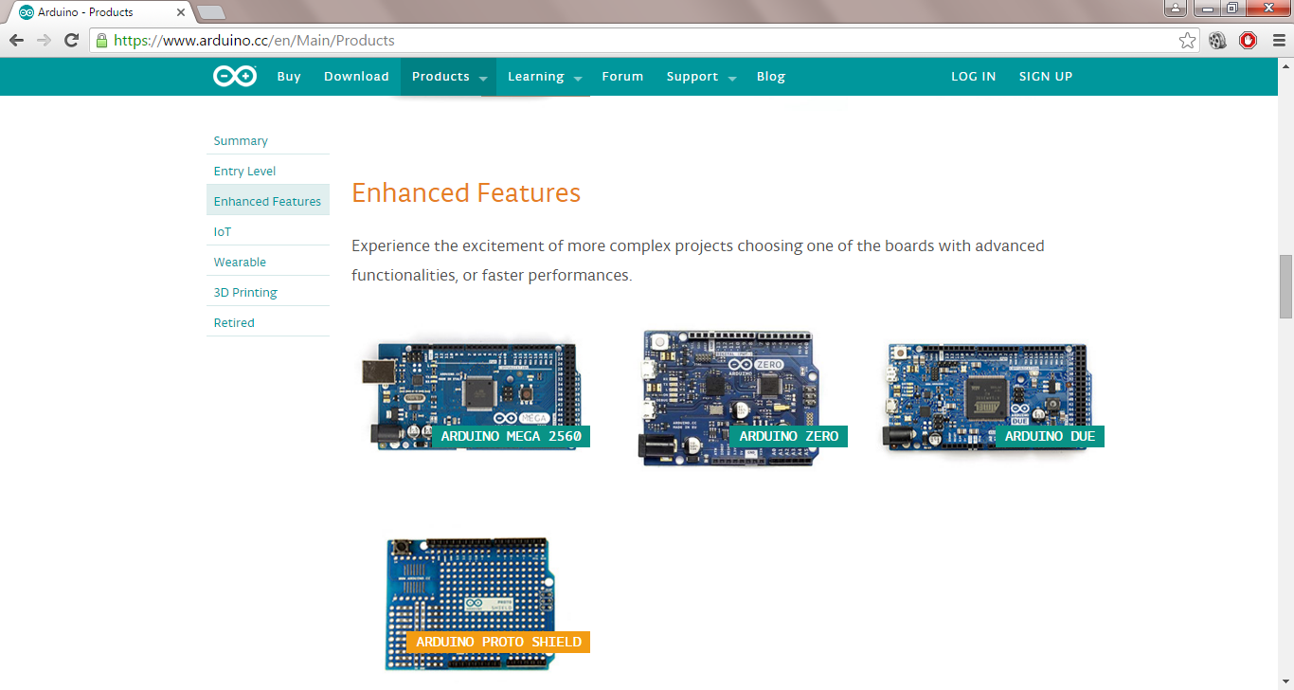
1.2 Different types of Arduino board

Slide 4

1.3 Why Arduino?
Inexpensive - Arduino boards are relatively inexpensive compared to other microcontroller platforms.
Cross-platform - The Arduino Software (IDE) runs on Windows, Macintosh OSX, and Linux operating systems. Most microcontroller systems are limited to Windows.
Simple, clear programming environment - The Arduino Software (IDE) is easy-to-use for beginners, yet flexible enough for advanced users to take advantage of as well.
Open source and extensible software - The Arduino software is published as open source tools, available for extension by experienced programmers.
Open source and extensible hardware - The plans of the Arduino boards are published under a Creative Commons license, so experienced circuit designers can make their own version of the module, extending it and improving it. Even relatively inexperienced users can build the breadboard version of the module in order to understand how it works and save money.
Reference:-https://www.arduino.cc/en/Guide/Introduction

Slide 5

Getting Started

Slide 6

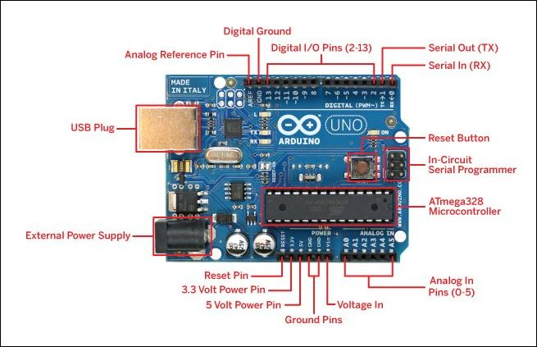
2.1 Arduino Pinout Diagram
Primary Pins
14 Digital Pins (D0-D13)
6 Anlaog Pins (A0-A5)
5V Pin
3.3V Pin
Ground Pins
Input Voltage (Vin)
Analog Reference Pin(AREF)
Reference:-https://www.arduino.cc/en/main/products

Slide 7
2.2 Arduino Specification
Microcontroller | ATmega328P
Operating Voltage | 5V
Input Voltage (recommended) | 7-12V
Input Voltage (limit) | 6-20V
Digital I/O Pins | 14 (of which 6 provide PWM output)
PWM Digital I/O Pins | 6
Analog Input Pins | 6
DC Current per I/O Pin | 20 mA
DC Current for 3.3V Pin | 50 mA
Flash Memory | 32 KB (ATmega328P) of which 0.5 KB used by bootloader
SRAM | 2 KB (ATmega328P)
EEPROM | 1 KB (ATmega328P)
Clock Speed | 16 MHz

Slide 8

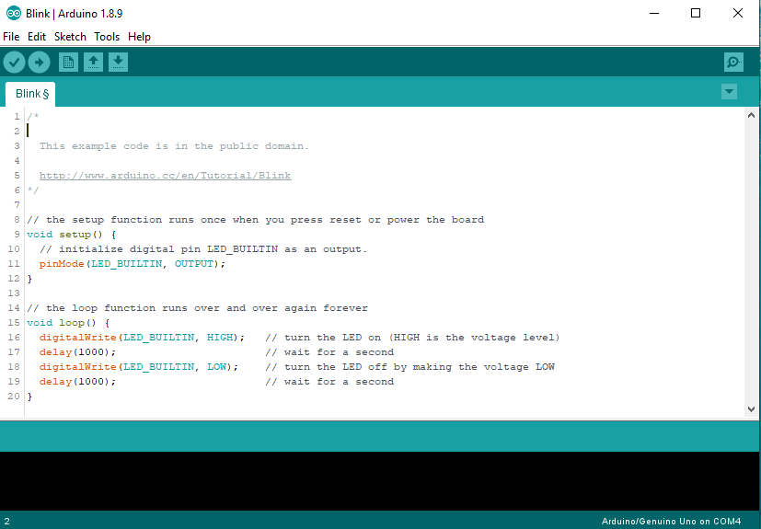
2.3 ARDUINO IDE

Slide 9

2.4 Bare Minimum
void setup() {
It is called only when the Arduino is powered on or reset. It is used to initialize variables and pin modes.
}
void loop() {
The loop functions runs continuously till the device is powered off. The main logic of the code goes here. Similar to while (1) for micro-controller programming
}

Slide 10

2.5 Steps for Compiling
Select your board
Select your serial port
Write Your Code​
Upload
Compile

Slide 11
Sensor Integration

Slide 12

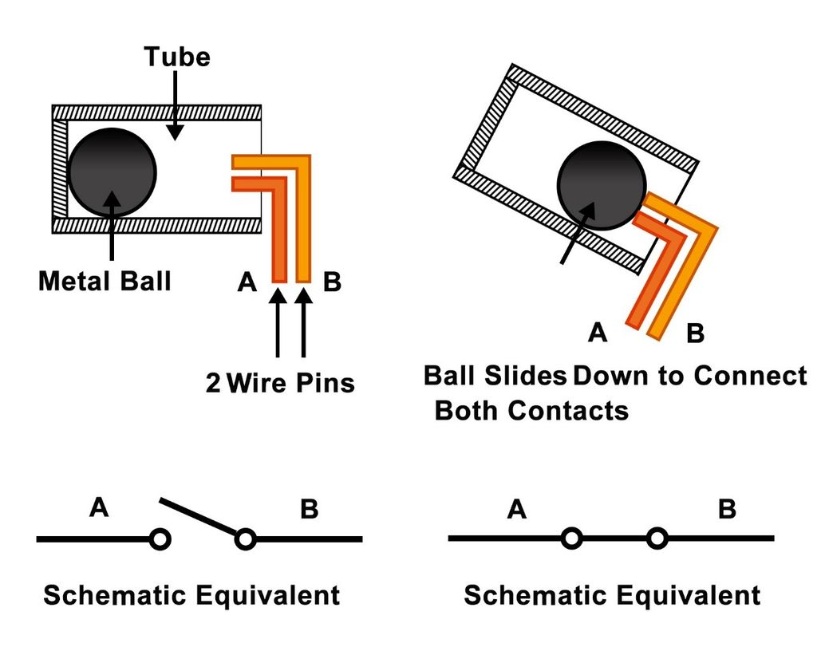
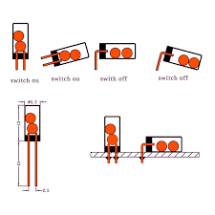
3.1 TILT SENSOR
​
A tilt sensor is an instrument that is used for measuring the tilt in multiple axes of a reference plane.
Specifications
Number of Axes
Resolution
Measuring Range
Sensitivity
Noise Tolerance
Output
Vibration
Reference-https://learn.adafruit.com/tilt-sensor

Slide 13
2.5 Steps for Compiling
Select your board
Select your serial port
Write Your Code​
Upload
Compile

Slide 14
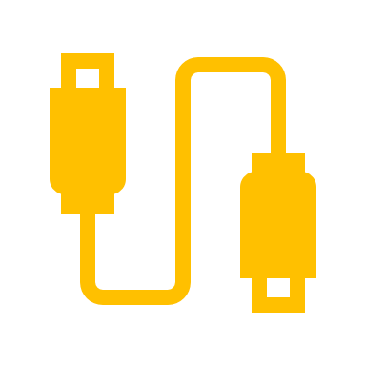
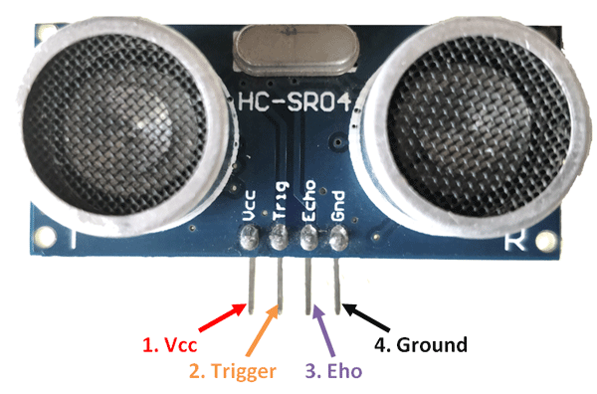
3.2 ULTRASONIC SENSOR
​​
An Ultrasonic sensor is a device that can measure the distance to an object by using sound waves
Applicaion:-
Sonograms (i.e. baby pictures)
Non-destructive examination (checking for internal cracks or voids)
Sonar (underwater detection of obstacles)
Welding (plastics or metals)
Cleaning (often jewelry)
Cutting / Slicing (fabrics, plastic films)
De-gating, staking, swaging, inserting (random plastic manufacturing processes)
Surgery (to make incisions)

Slide 15

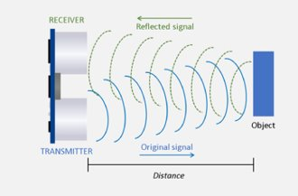
ULTRASONIC
CALCULATION
Speed of Sound at 0*C= 331.5 m/s
Speed of Sound at 20*C = 343.5 m/s
= 343.5*100 cm/us
10⁶
= 0.03435 cm/us
Velocity= Displacement / time
Displacement(D) = velocity*time
= 0.03435*time
= time
1/0.03435
Displacement(to and fro) = time/29.2
Displacement = time/(2*29.2)

Slide 16
2.5 Steps for Compiling
Select your board
Select your serial port
Write Your Code​
Upload
Compile

Slide 17
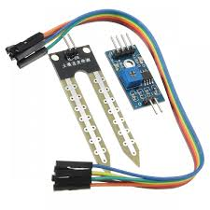
VCC: For power
A0: Analog output
D0: Digital output
GND: Ground
3.3 Soil Moisture
A soil moisture sensor measures the quantity of water contained in a material, such as soil on a volumetric or gravimetric basis.
A Pin Out – Soil Moisture Sensor
The soil Moisture sensor FC-28 has four pins
VCC: For power
A0: Analog output
D0: Digital output
GND: Ground
The Module also contains a potentiometer which will set the threshold value and then this threshold value will be compared by the LM393 comparator. The output LED will light up and down according to this threshold value.

Slide 18

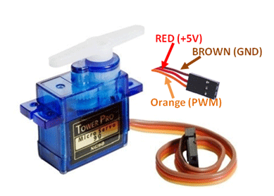
3.3 Servo Motor
A servomotor is a rotary actuator or linear actuator that allows for precise control of angular or linear position, velocity and acceleration
Features to be considered
Operating Voltage
Torque
Operating speed
Gear Type
Rotation range
Weight of motor
Package includes gear horns and screws
Applications
Used as actuators in many robots like Biped Robot,robotic arm etc.
Commonly used for steering system in RC toys
Robots where position control is required without feedback
Reference-https://components101.com/servo-motor-basics-pinout-datasheet

Slide 19

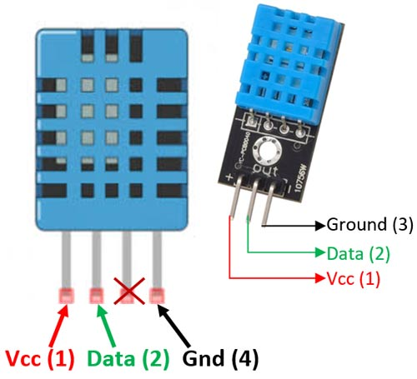
3.4 DHT11
Operating voltage | 3.3V-5.5V
Humility measuring range | 20%-95%（0℃-50℃）
Humility measuring error | +-5%
Temperature measuring range | 0℃-50℃
Temperature measuring error | +-2℃
Features to be considered​
Accuracy
Linearity
Reliability
Repeatability
Response
Reference:-https://electronicsforu.com/resources/electronics-components/humidity-sensor-basic-usage-parameter

Slide 20

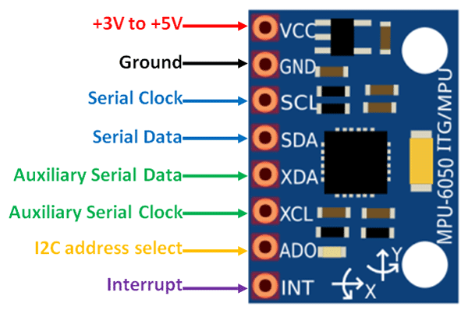
3.5 MPU6050
MPU6050 is a Micro Electro-mechanical system (MEMS), it consists of three-axis accelerometer and three-axis gyroscope. It helps us to measure velocity, orientation, acceleration, displacement and other motion like features.
Applications:-
It is used for IMU measurement.
It can be used in Drones / Quadcopters as direction controller.
It used in Self-balancing robots.
It can use as Robotic arm controls.
It can be used in Humanoid robots
It used in Tilt sensor.
It can be used orientation or Rotation Detector.
Reference:-https://www.theengineeringprojects.com/2019/02/introduction-to-mpu6050.html

Slide 21

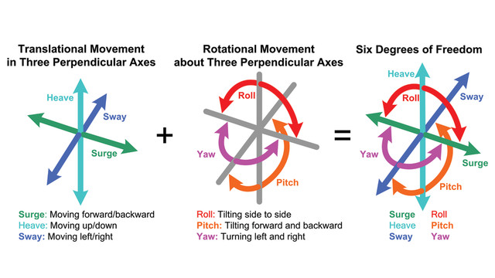
What’s DoF?
DoF stands for degrees of freedom. It’s the ability for a solid to move into space along—and around—an axis, x, y or z.
Translation Movement
A body is free to translate in 3 degrees of freedom: forward/back, up/down, left/right.
Rotation Movement
A body can also rotate with 3 degrees of freedom: pitch, yaw, and roll.
3 types of translation + 3 types of rotation = 6 DOF!
http://www.leadingones.com/articles/intro-to-vr-4.html

Slide 22

Communication Protocol

Slide 23

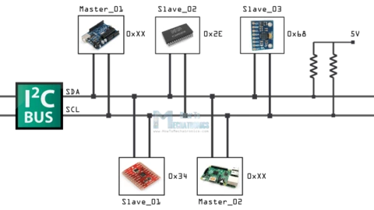
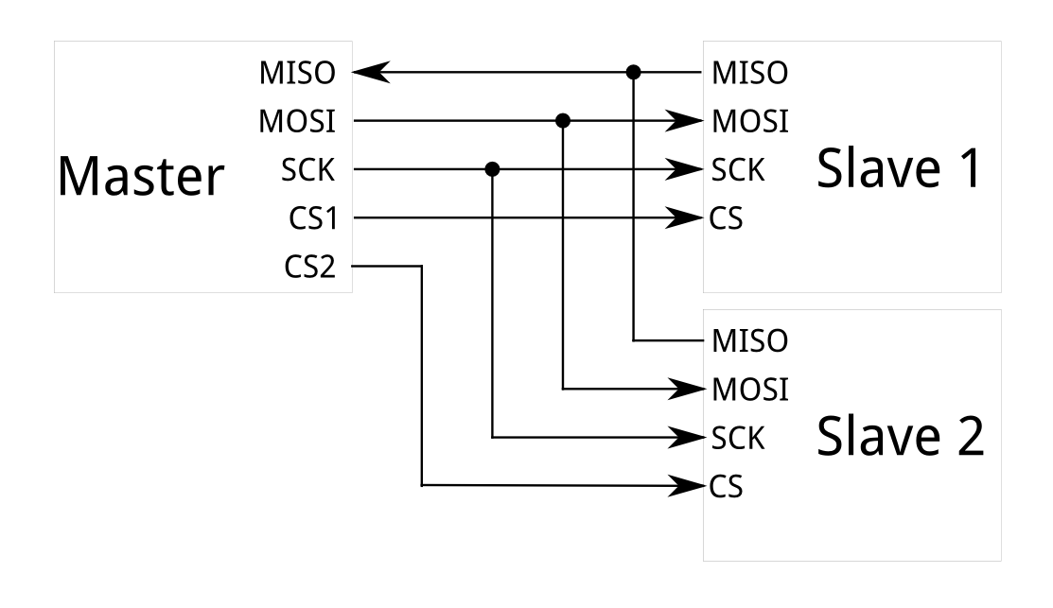
What is I2C?
I2C is a serial communication protocol. It provides the good support to the slow devices, for example, EEPROM, ADC, and RTC etc.I2c are not only used with the single board but also used with the other external components which have connected with boards through the cables.
I2C is basically a two-wire communication protocol. It uses only two wire for the communication. In which one wire is used for the data (SDA) and other wire is used for the clock (SCL).
In I2C, both buses are bidirectional, which means master able to send and receive the data from the slave. The clock bus is controlled by the master but in some situations slave is also able to suppress the clock signal, but we will discuss it later.
https://learn.sparkfun.com/tutorials/i2c/all
https://www.superhouse.tv/i2c-for-arduino/

Slide 24

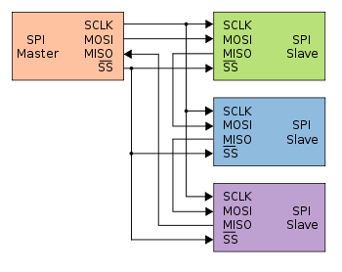
What is SPI?
The serial peripheral interface is four wire-based full duplex communication protocol these wire generally known as MOSI (master out slave in), MISO (master in slave out), SCL (a serial clock which produces by the master) and SS (slave select line which use to select specific slave during the communication).
SPI follows the master and slave architecture and communication is always started by the master. It is also an synchronous communication protocol because the clock is shared by master and slave.
https://en.wikipedia.org/wiki/Serial_Peripheral_Interface

